Slide 1

Library Management System
(GUI Development with Javafx)

Slide 2
Overview
  A Library Management System (LMS) is software used to manage daily library operations.
  Helps in organizing books, members, and transactions.
  Reduces manual work and errors.
  Speeds up book issuing, returning, and searching.
  Enhances data security, preventing loss of records.
  Saves time for both librarians and users by automating repetitive tasks.
  Improves user experience with an organized and easy-to-use interface.

Slide 3
System Architecture
  User Interface – For librarians and students to interact.
  Database – Stores data about books, members, and transactions.
  Application Layer – Handles logic like issuing, returning, searching books.
  Admin Panel – For managing users and books.
Components:
Workflow:
Users → UI → Application Layer → Database → UI output.

Slide 4
Features-
  Book Management:
Add, update, delete books; categorize by author, genre, ID.
2.Member Management:
Register members, update info.
  Issue & Return System:
Track borrowing, due dates, and fines.
4.Search Module:
Search books by title, subject, author, etc.
5.Reports:
Daily activity, issued books, fines collected, inventory.

Slide 5
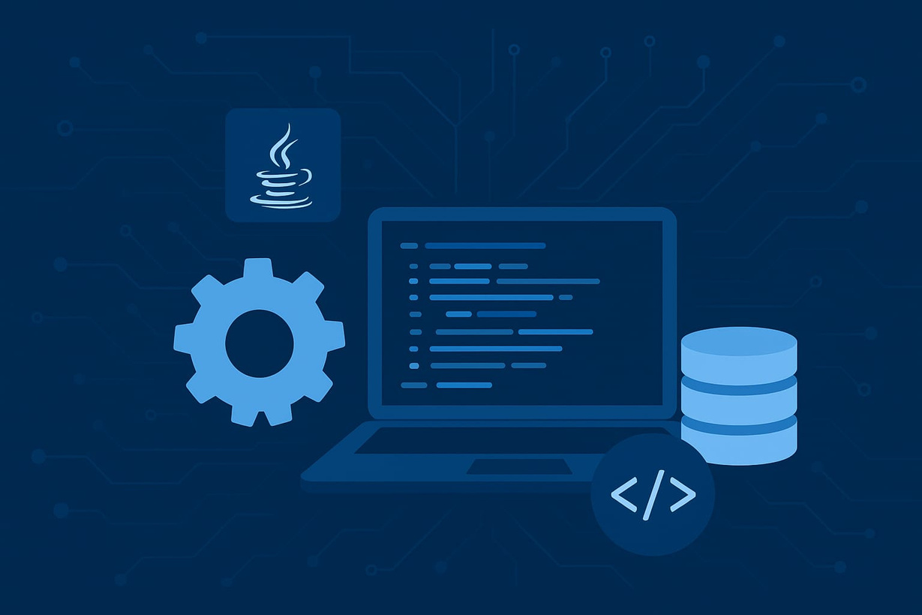
Technical setup
  IDE - Intellij
  Java Version - JDK 25+
  Libraries - Javafx SDX
  Database Tables - Books, Users
, IssuedBooks
  Build tools - Maven

Slide 6

Thank You!
Developed by:
1) Sharanya Pandey
2) Janvi Singh
3) Pooja Verma

